Slide 1
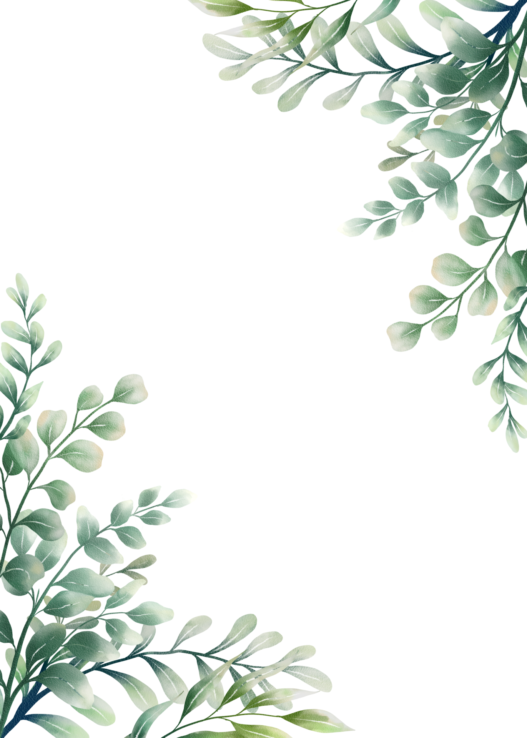
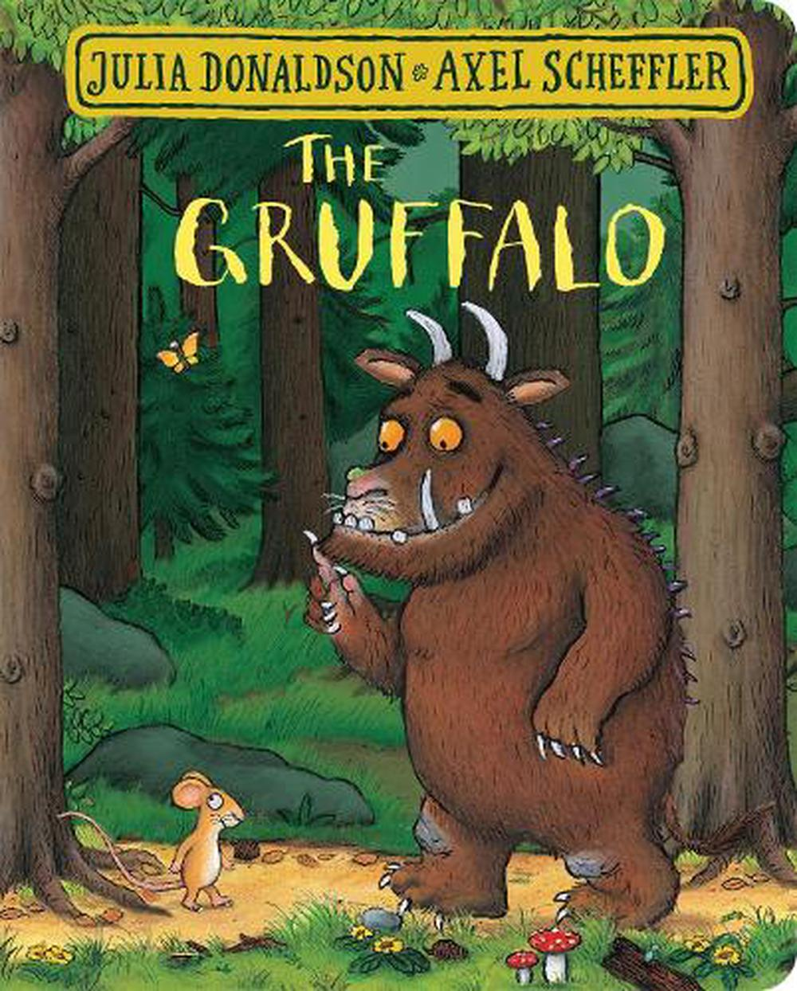
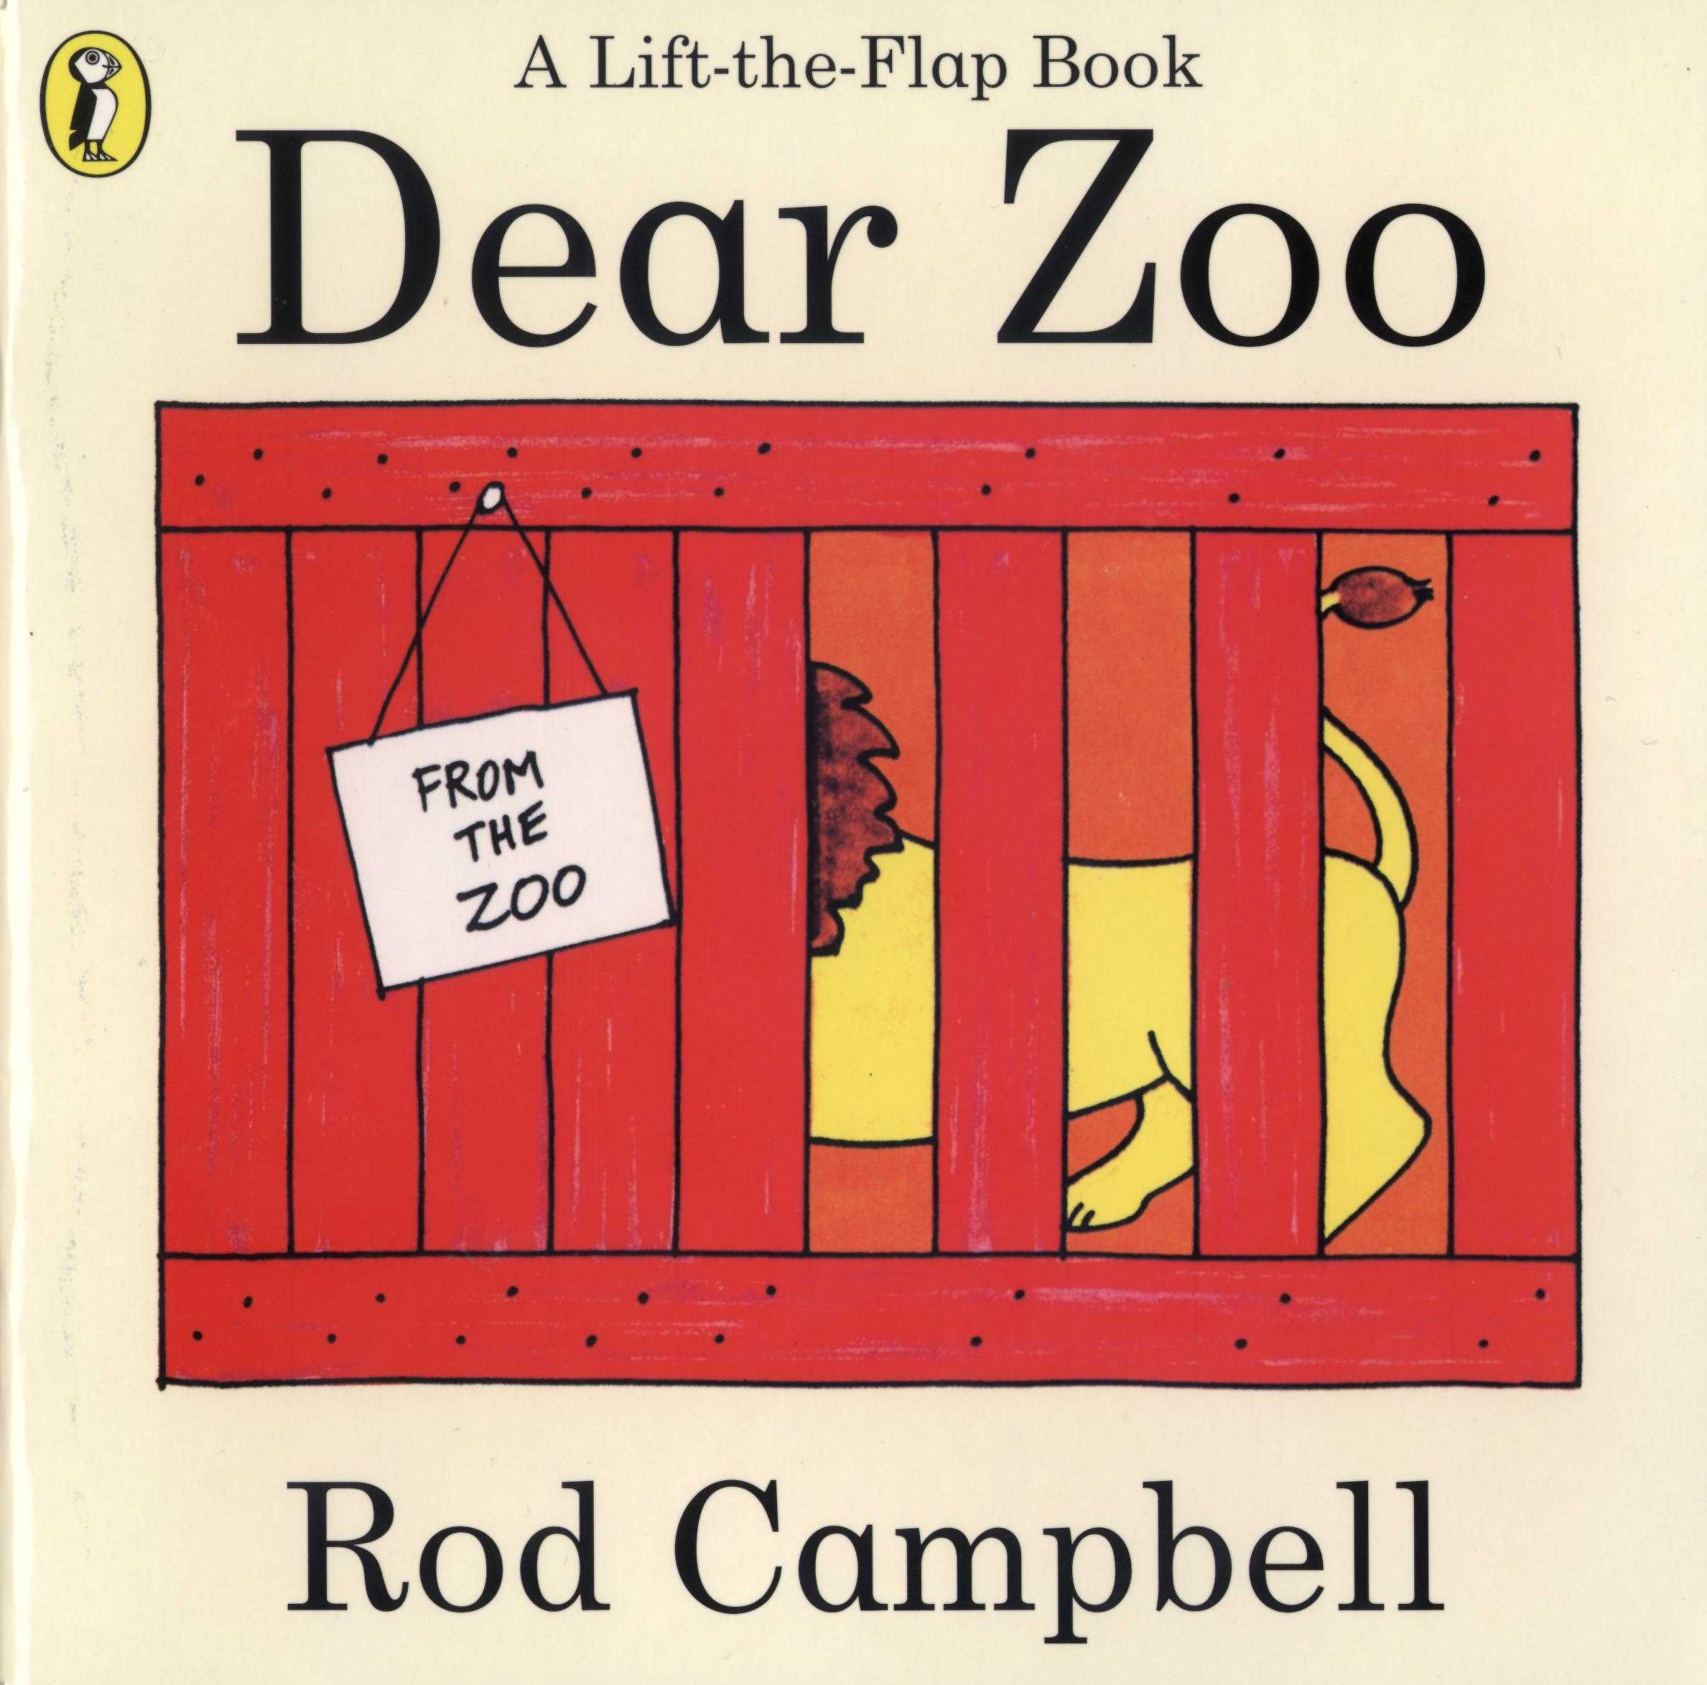

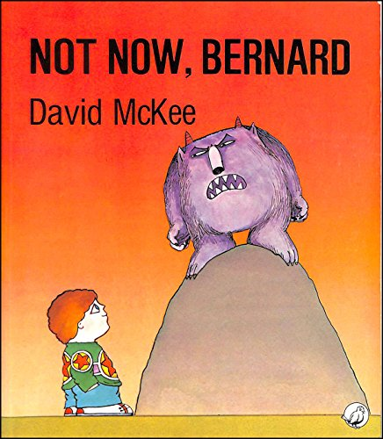
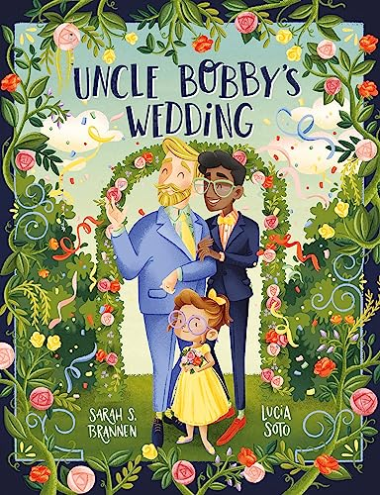
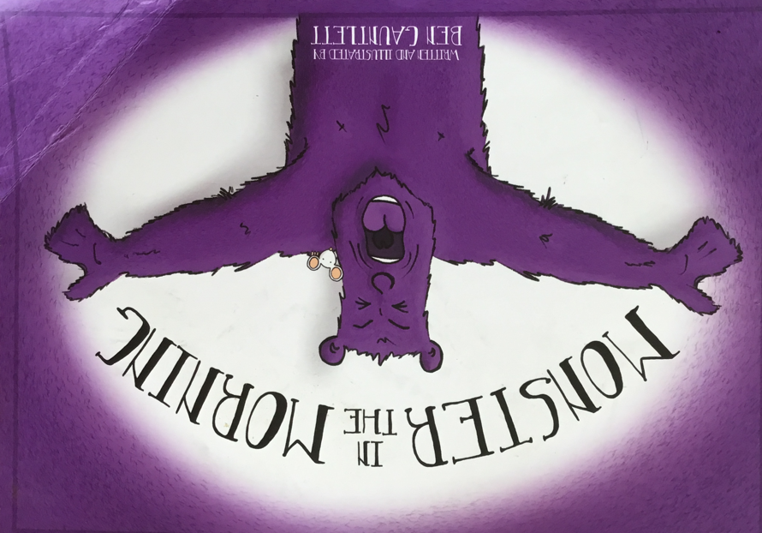
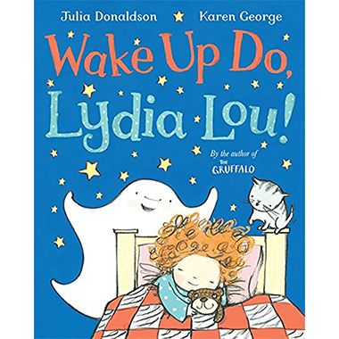
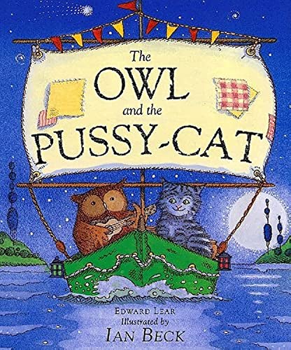
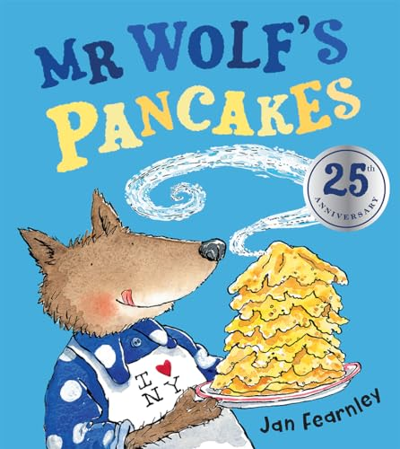


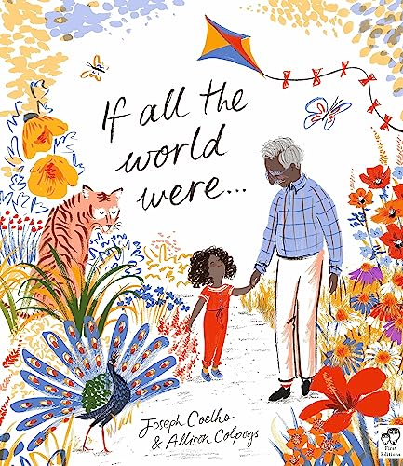
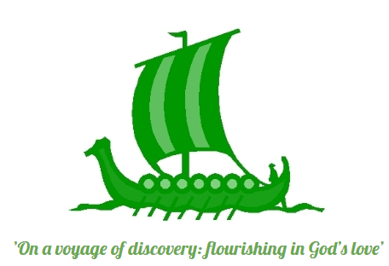

Reading for Pleasure Spine
Windmills - EYFS
The Gruffalo Julia Donaldson COURAGE | Dear Zoo Rod Campbell | Farmer Duck Martin Waddell COOPERATION | Not Now Bernard David McKee | Uncle Bobby’s Wedding Sarah Brannan COMPASSION | Monster in the Morning Ben Gauntlett
Wake up do Lydia Lou! Julia Donaldson | The Owl and the Pussycat Edward Lear | Mr Wolf’s Pancakes Jan Fearnley | Big Book of Beasts/ Blue Yuval Zommer | The Invisible Tom Percival | If all the World Were… Joseph Coelho
Nursery Rhymes: One Two Buckle my Shoe, The Grand Old Duke of York, Hickory Dickory Dock, Head Shoulders Knees and Toes, Animals came in two by two. |  |  | Poetry: Julia Donaldson Poems to Perform – Pirate Pete John Foster – Chanting Rhymes – I don’t like Custard John Foster – Chanting Rhymes – Spaghetti
Compare Reflect Discover

Slide 2
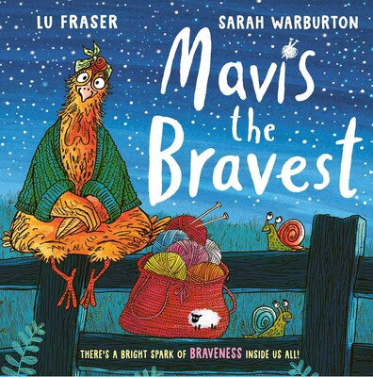



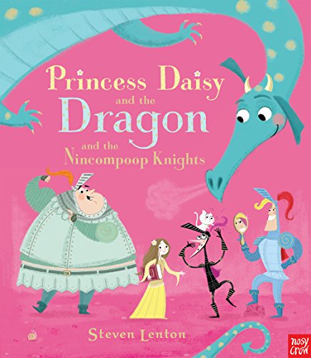
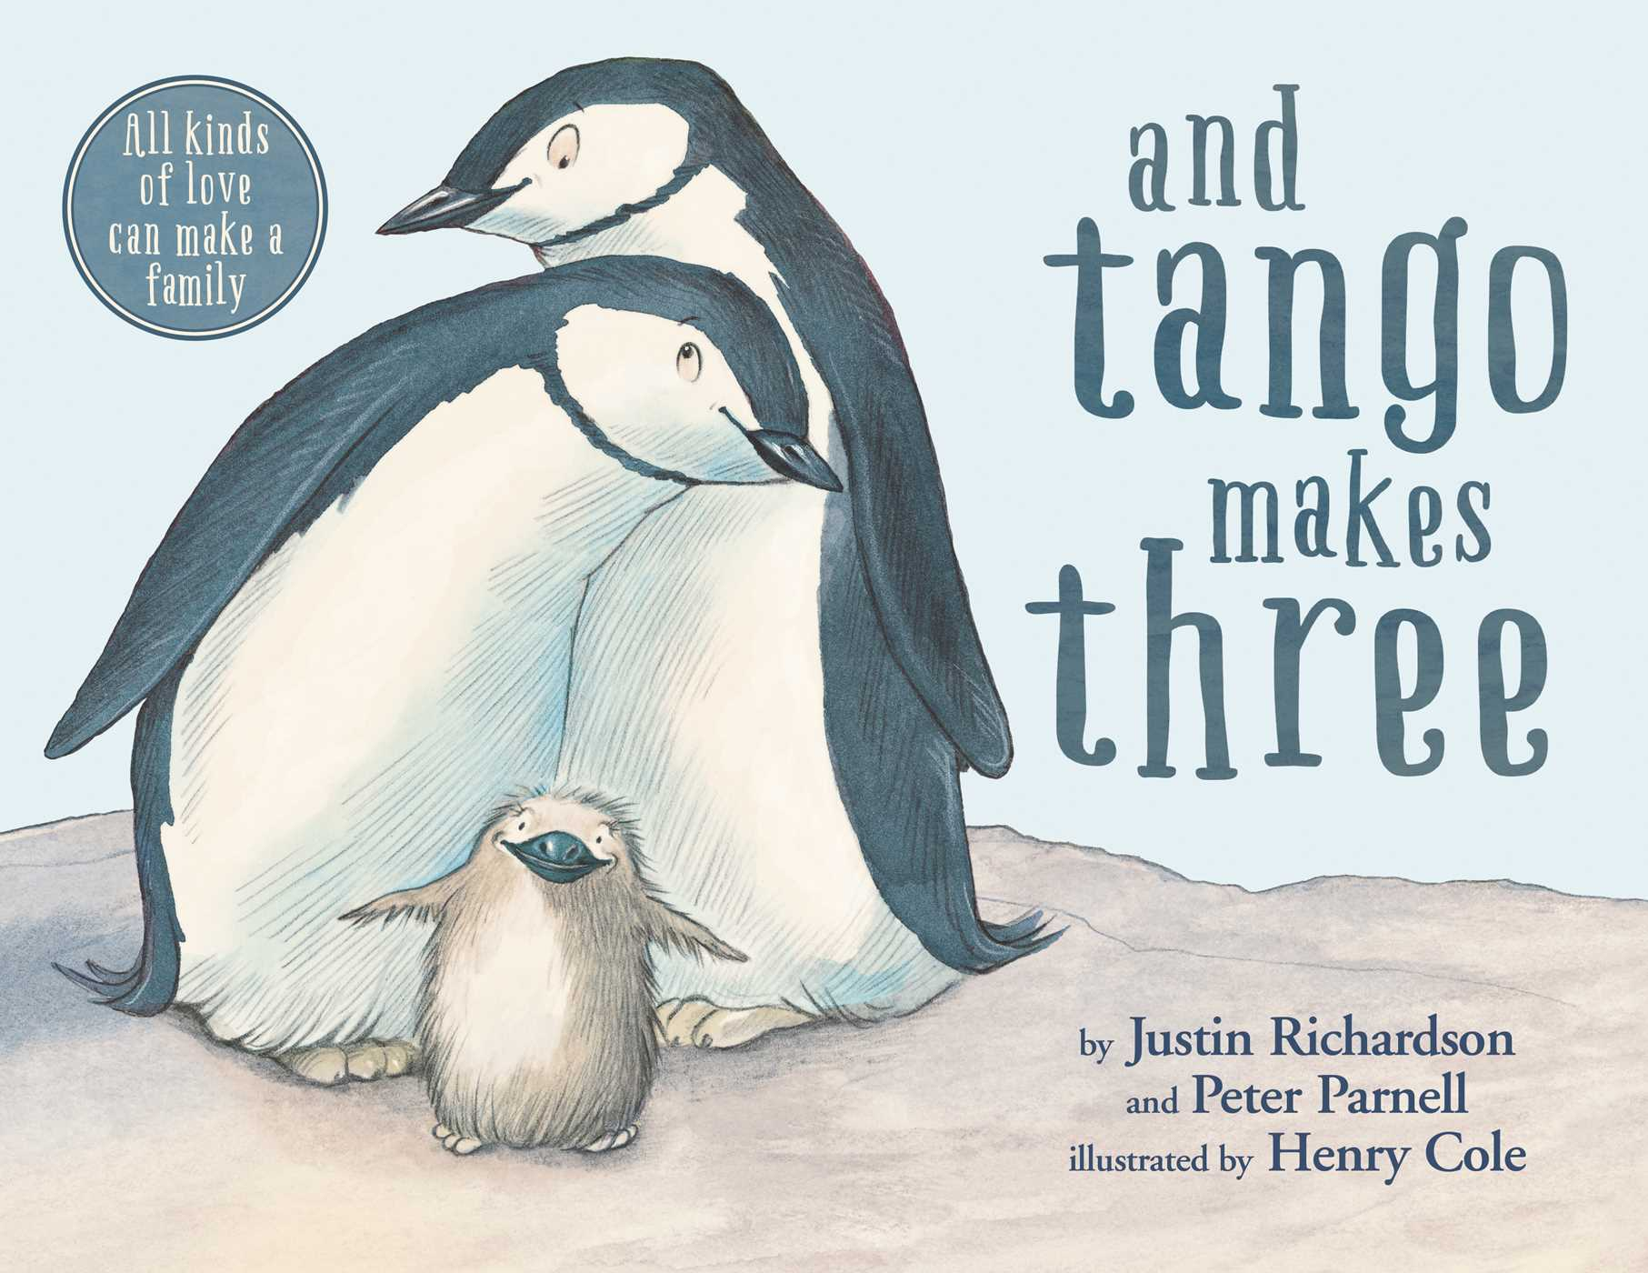
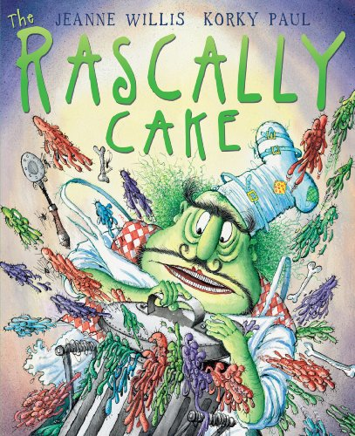
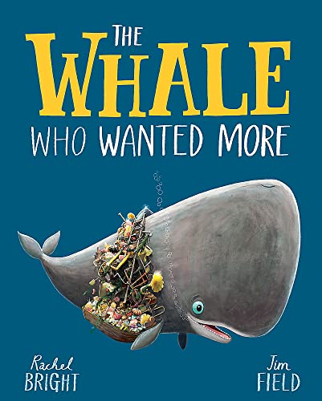

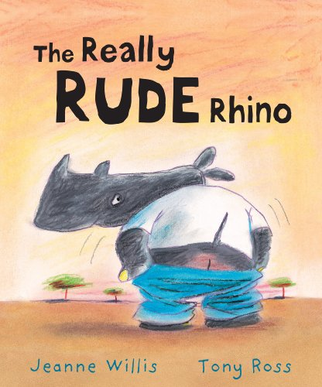

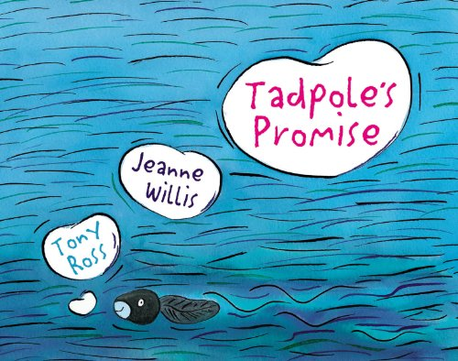
Reading for Pleasure Spine
Oast – Year One
Mavis the Bravest Lu Fraser COURAGE | The Tiger who came to Tea Judith Kerr | Dick the Delightful Duck Kate Umansky COOPERATION | The Enormous Crocodile Roald Dahl | Princess Daisy & the Dragon Steven Lenton COMPASSION | Tango makes Three Justin Richardson
Rascally Cake Jeanne Willis | Tadpole’s Promise Jeanne Willis | The Whale who wanted more Rachel Bright | Big Book of Birds/ Bugs Yuval Zommer | The Really Rude Rhino Jeanne Willis | Look Up! Nathan Bryon
Traditional Tales: The Elves and the Shoemaker The Magic Porridge Pot |  |  | Poetry: Julia Donaldson Poems to Perform – Hands Julia Donaldson Poems to Perform – Trouble with my Brother Roald Dahl Dirty Beasts – The Scorpion, The Cow
Compare Reflect Discover

Slide 3


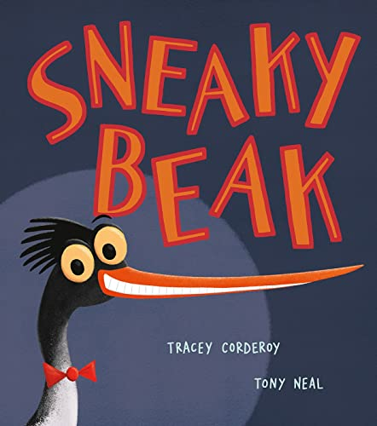
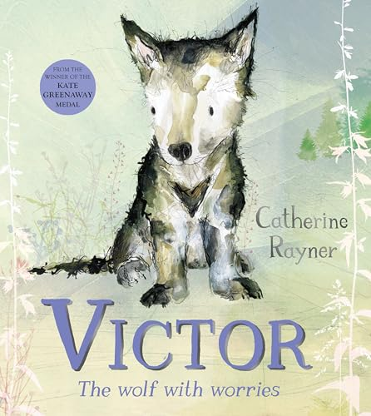
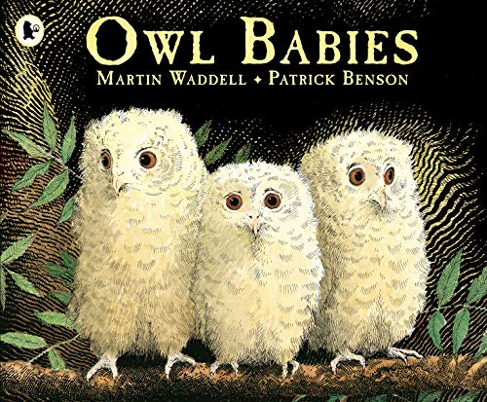
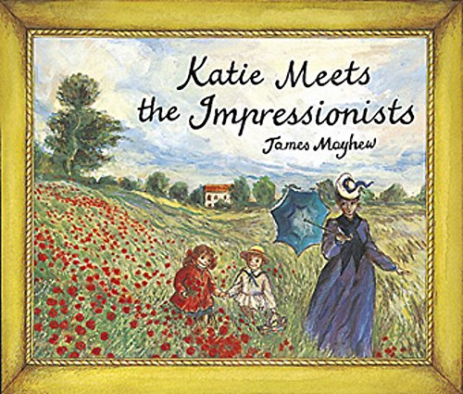
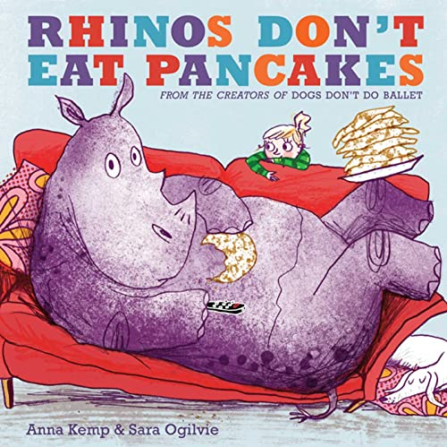
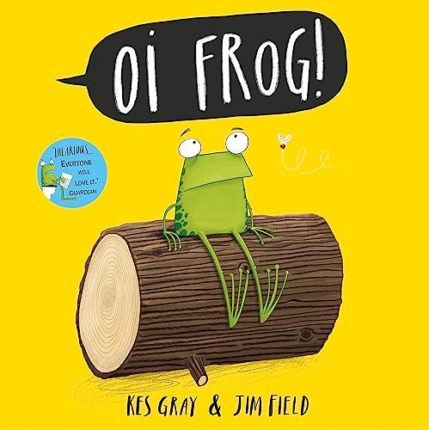
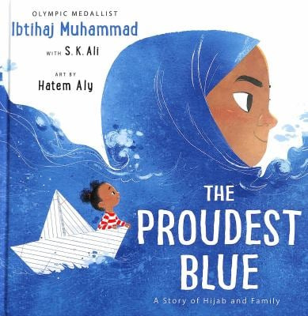


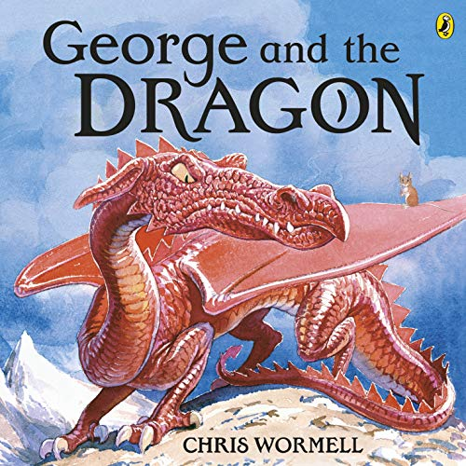
Reading for Pleasure Spine
Smugglers– Year Two
Victor the Wolf with Worries Catherine Rayner COURAGE | Owl Babies Martin Waddell | Billy’s Beetle Mick Inkpen COOPERATION | The Twits Roald Dahl | Sneaky Beak Tracey Corderoy COMPASSION | Katie meets the Impressionists James Mayhew
Rhinos don’t eat Pancakes Anna Kemp | George and the Dragon Christopher Wormell | Oi Frog! Kes Gray | Big Book of Blooms/ Belonging Yuval Zommer | We’re Going to find a monster Malorie Blackman | The Proudest Blue Ibtihaj Muhammad
Traditional Tales: The Gingerbread Man Goldilocks and the Three Bears |  |  | Poetry: Julia Donaldson Poems to Perform – I don’t want to go into school Julia Donaldson Poems to Perform – Dinosaur rap Roald Dahl Dirty Beasts – Tummy Beast, Ant Eater
Compare Reflect Discover

Slide 4

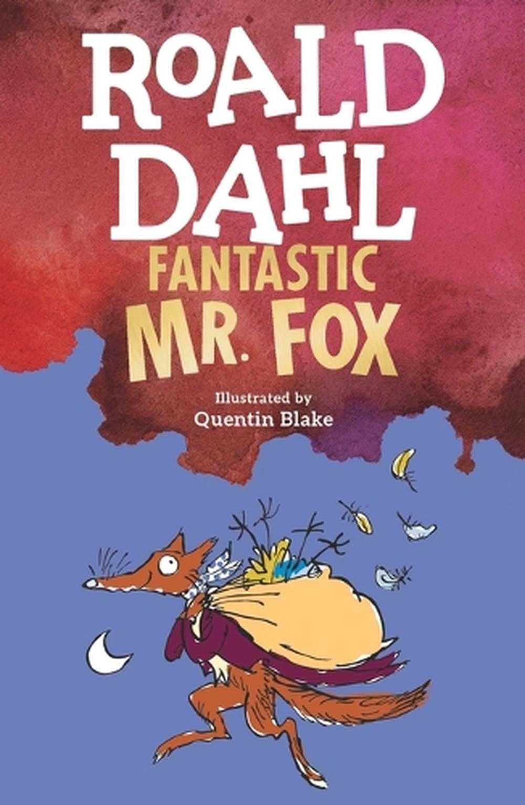
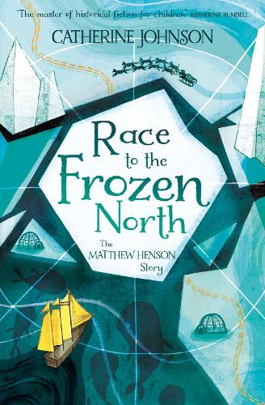
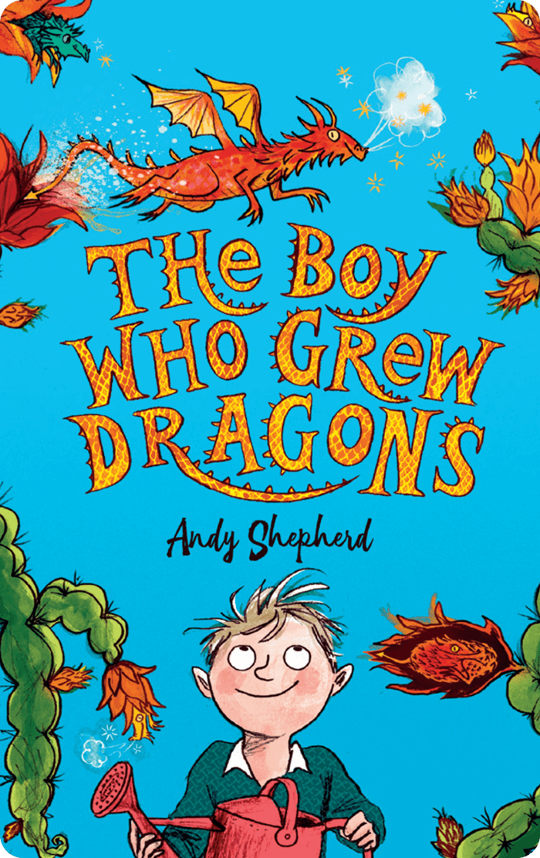
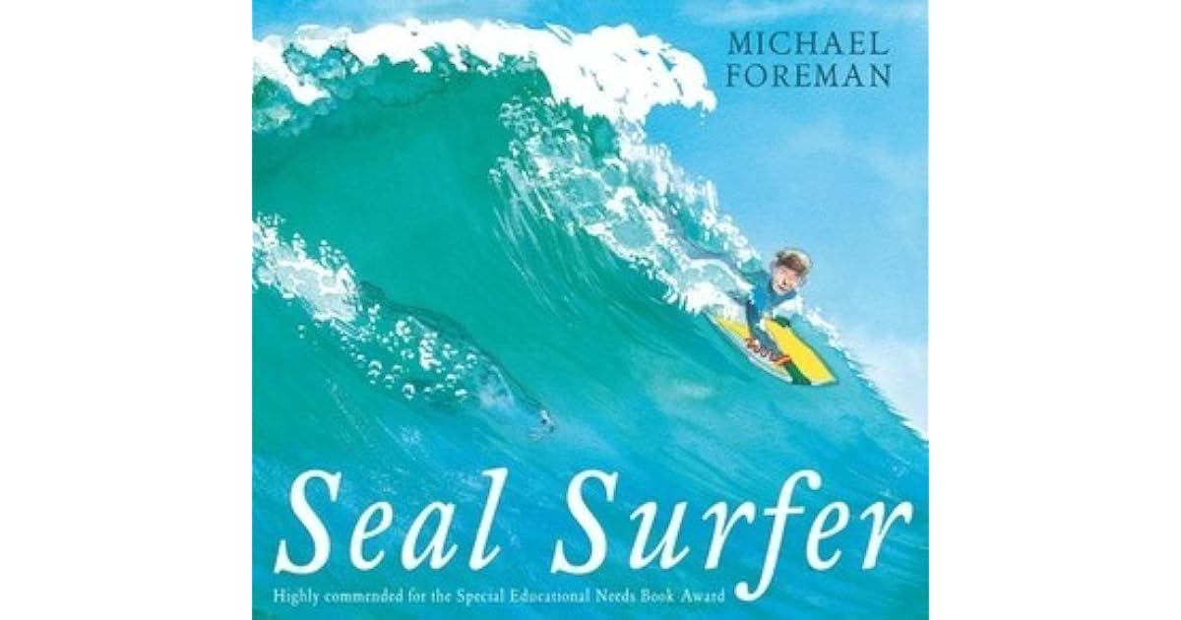
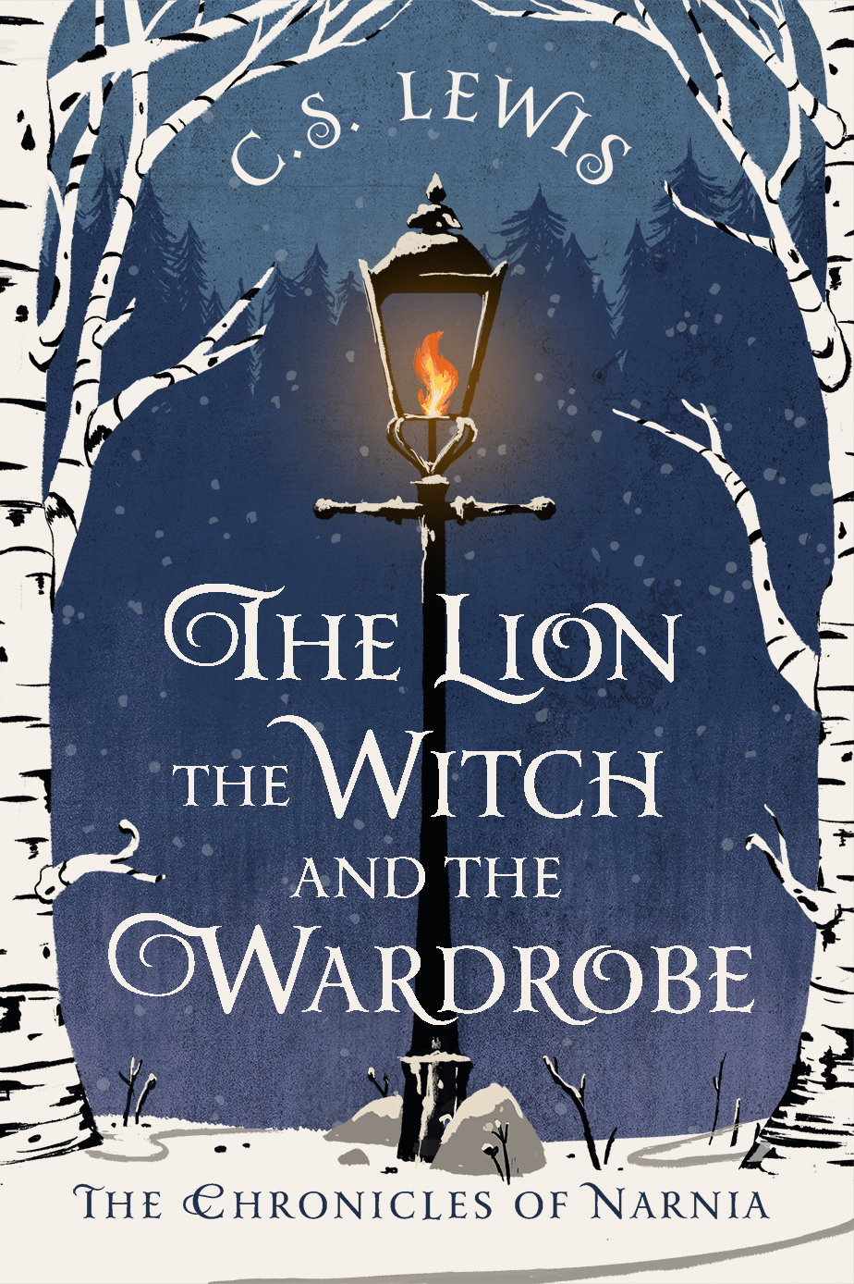
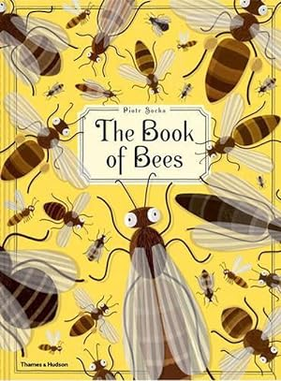
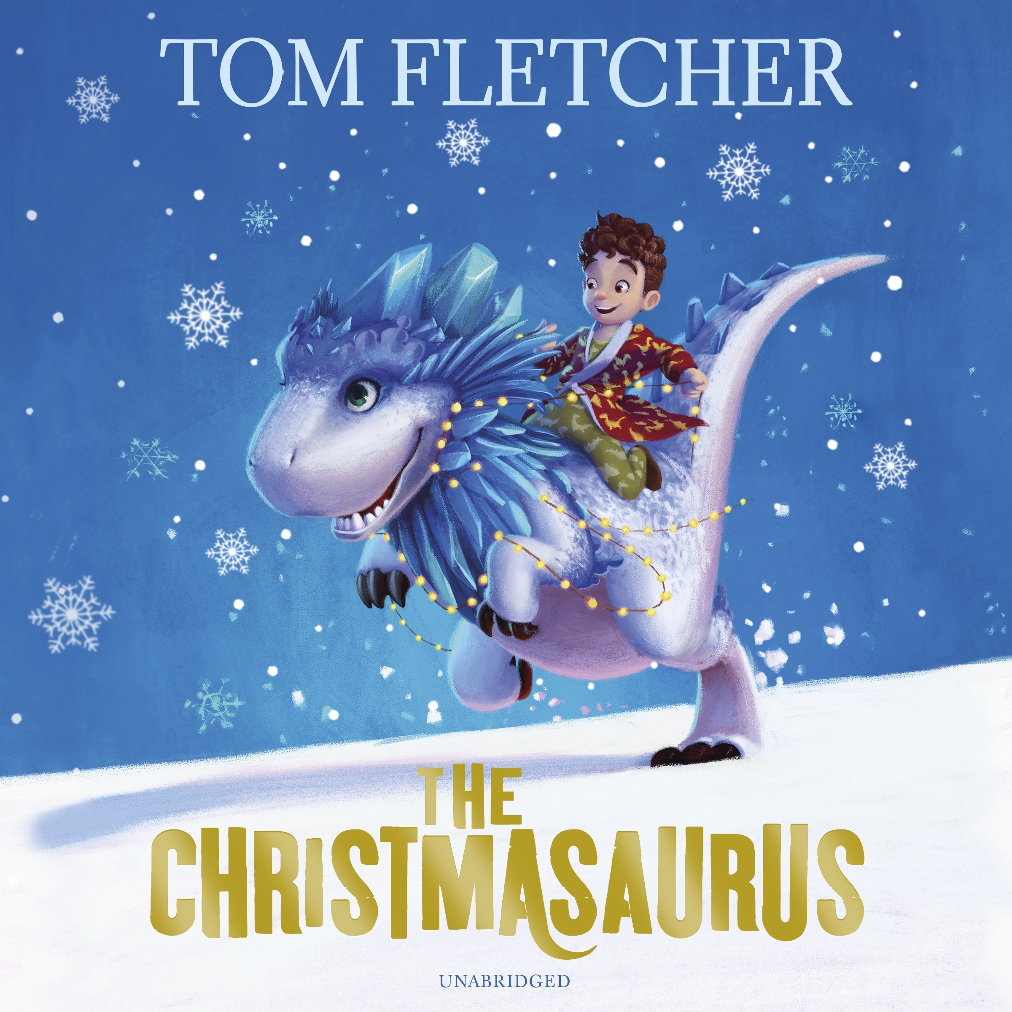
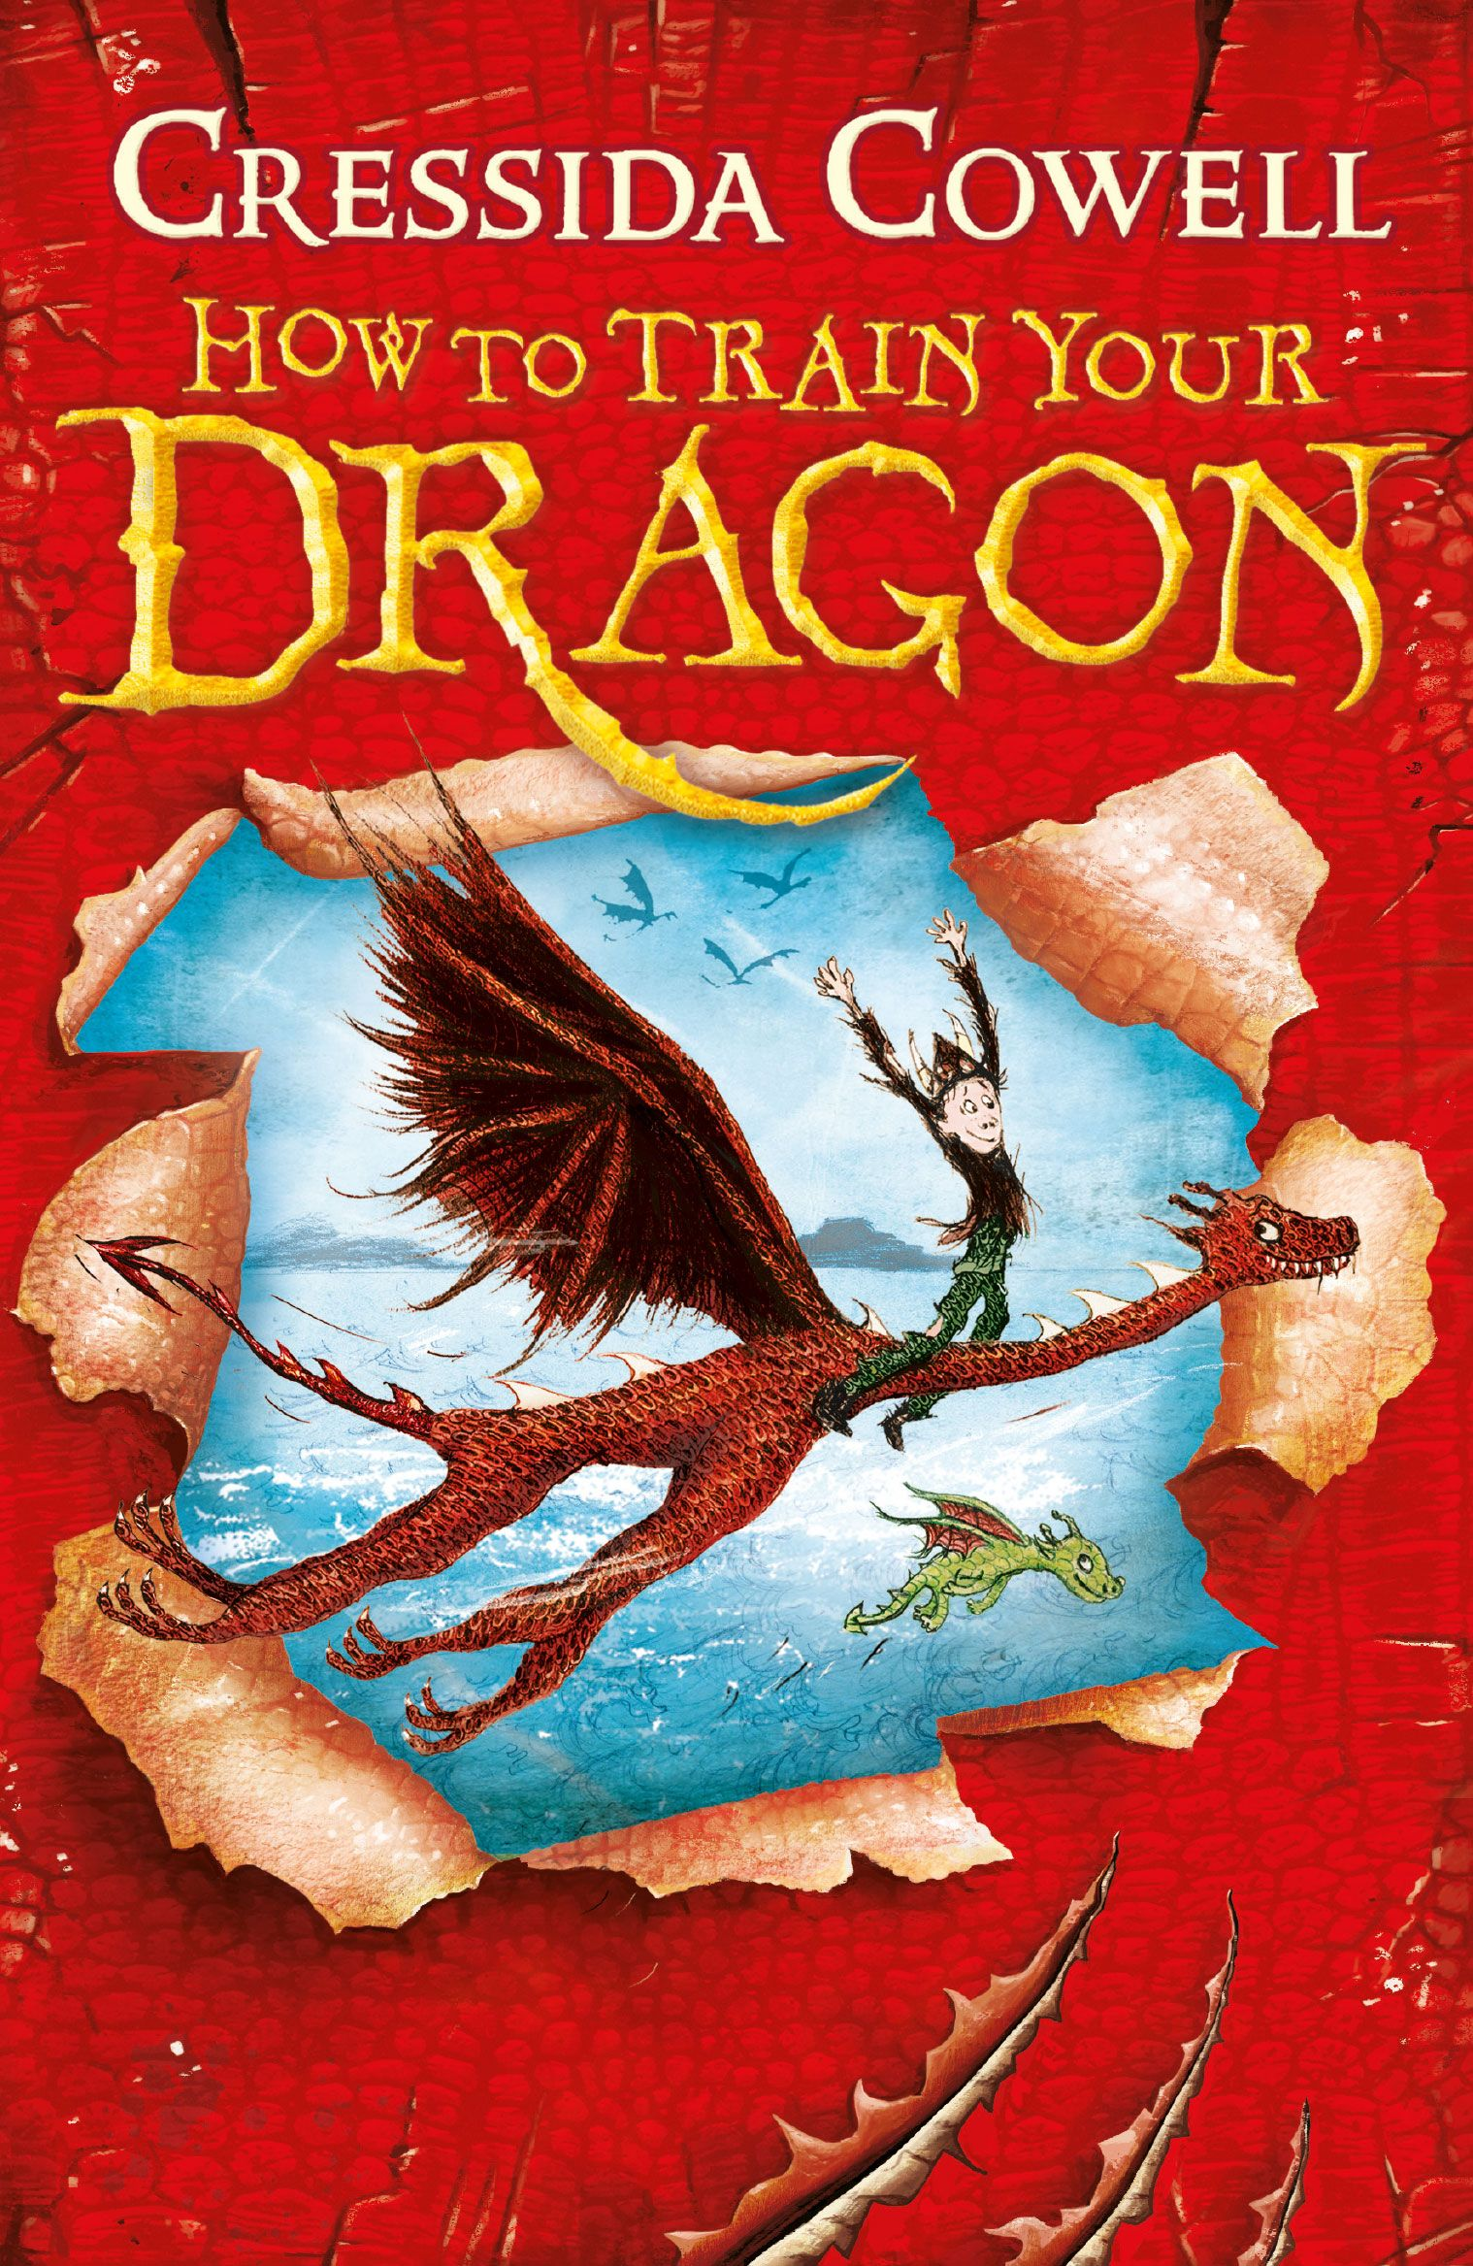

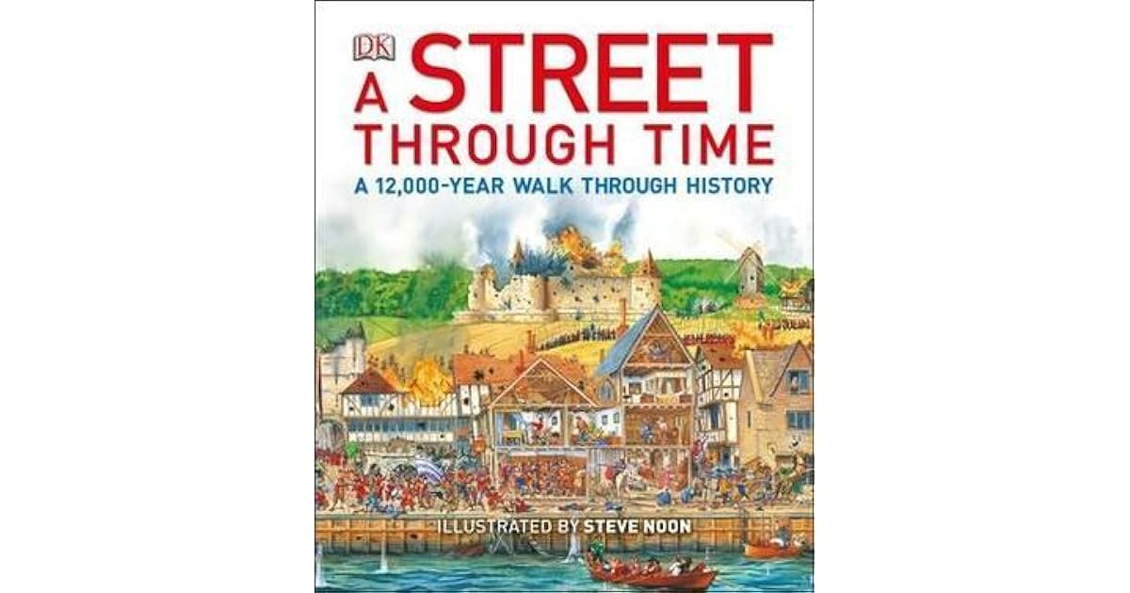
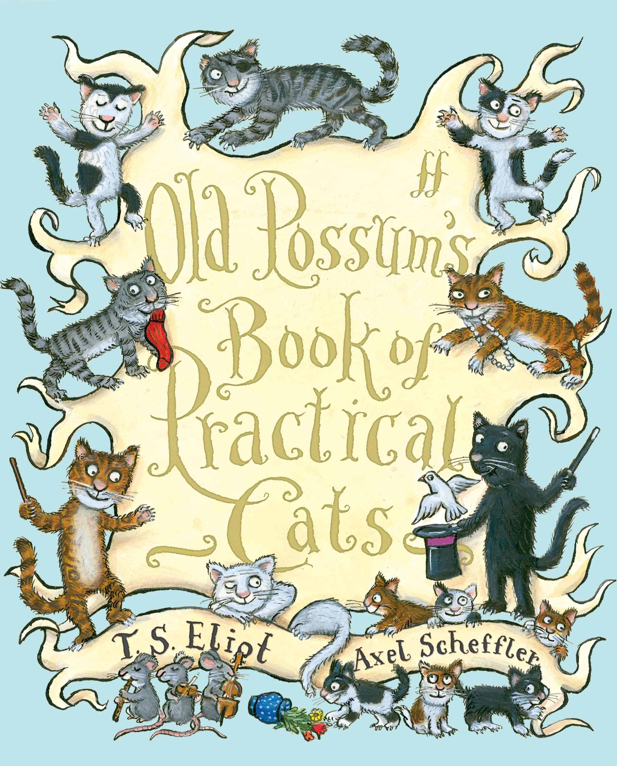
Reading for Pleasure Spine
Vikings – Year Three
Race to the Frozen North Catherine Johnson COURAGE | The Boy who Grew Dragons Andy Shepard | Butterfly Lion Michael Morpurgo COOPERATION | Fantastic Mr Fox Roald Dahl | Seal Surfer Michael Foreman COMPASSION | The Lion, the Witch and the Wardrobe CS Lewis
How to Train your Dragon Cressida Cowell | Three Cheers for Women Marcia Williams | A Street Through Time DK | The Book of Bees Piotv Socha | Old Possum’s Book of Practical Cats TS Eliot | Christmasaurus Tom Fletcher
Poetry: The Lost Words – Robert MacFarlane
Compare Reflect Discover

Slide 5
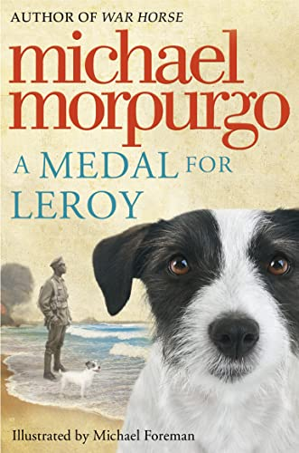
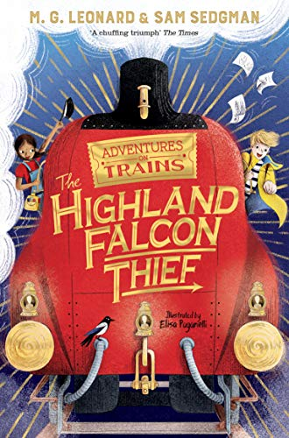
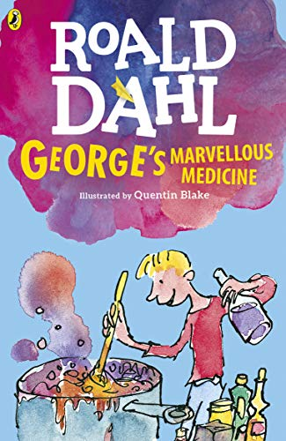



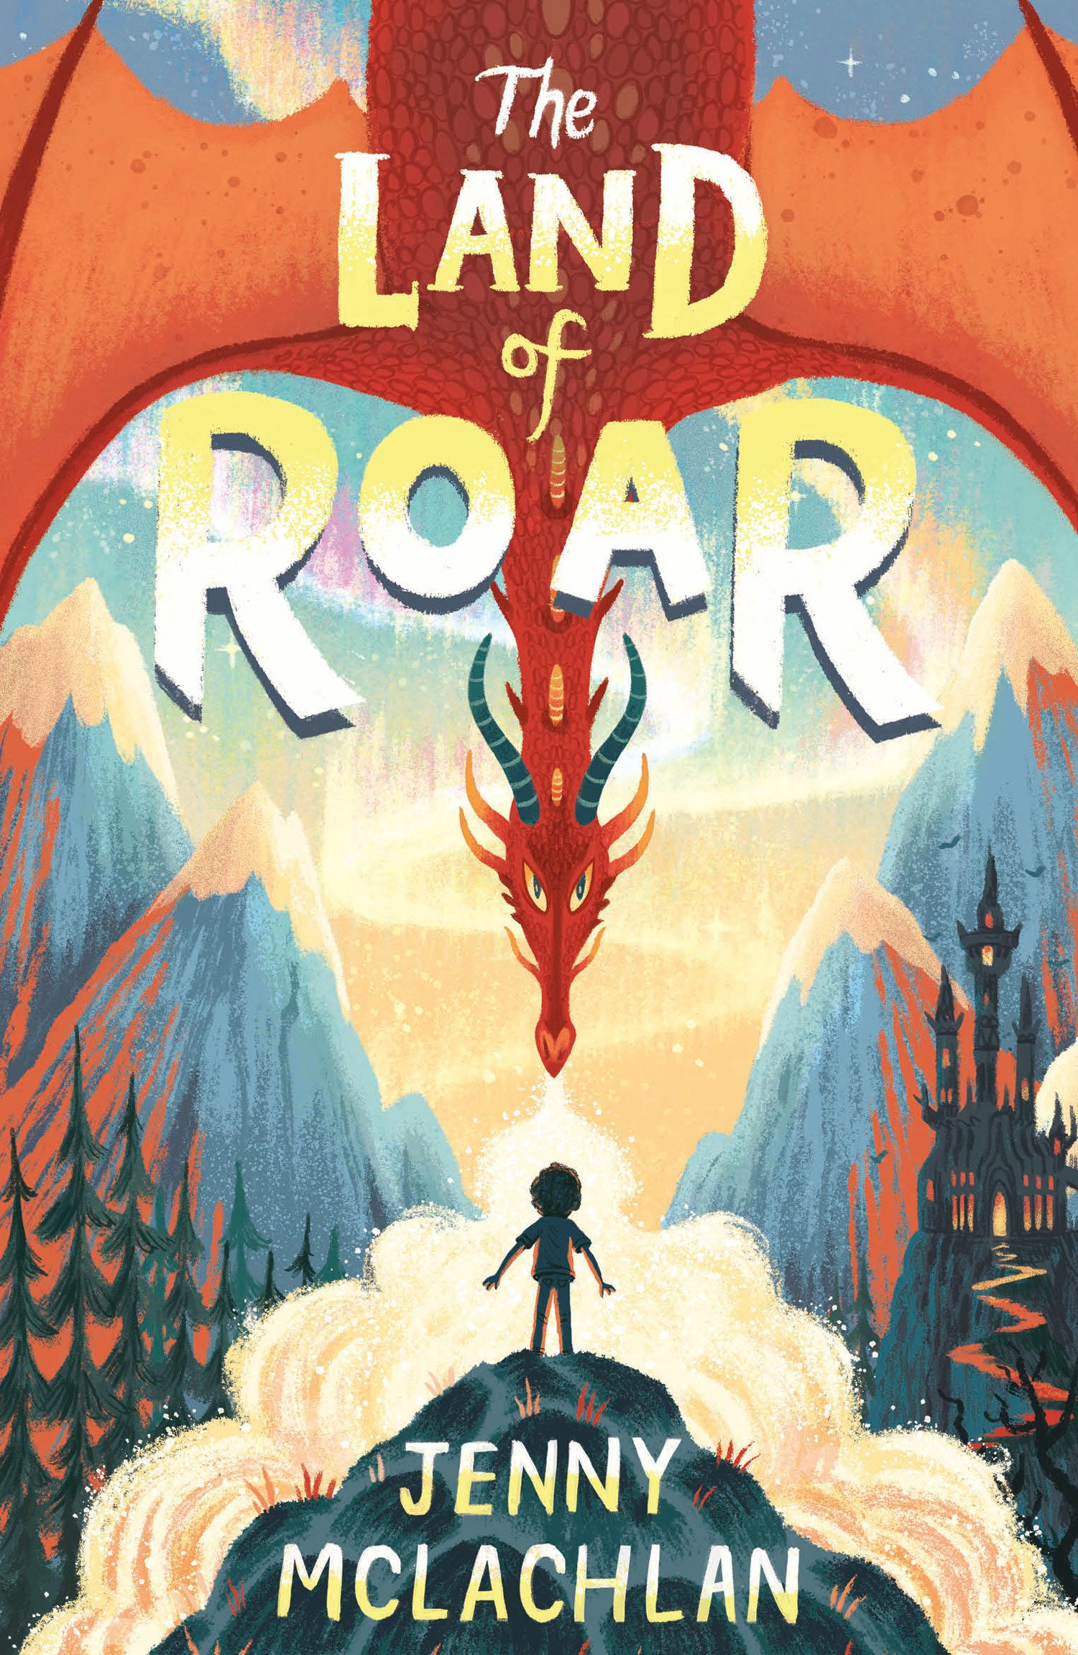
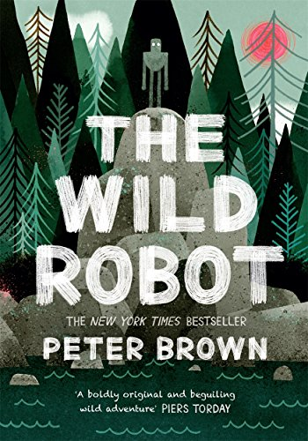

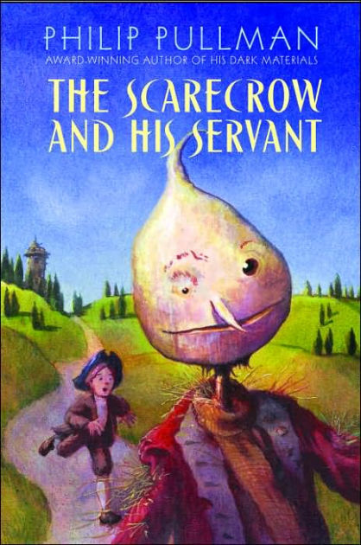
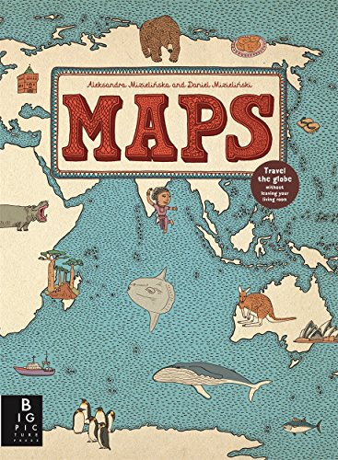

Reading for Pleasure Spine
Vikings & Oxney – Year Four
Medal for Leroy Michael Morpurgo COURAGE | The Brilliant World of Tom Gates Liz Pichon | The Highland Falcon Thief MG Leonard COOPERATION | George’s Marvellous Medicine Roald Dahl | The Unforgotten Coat Frank Cotterell Boyce COMPASSION | Anisha – Accidental Detective Serena Patel
The Scarecrow and his Servant Phillip Pullman | The Land or Roar Jenny McLachlan | Maps Alexandra Mizielinska | The Wild Robot Peter Brown | The Boy at the Back of the Class Onjali Rauf | Fing David Walliams
Poetry: The Lost Words – Robert MacFarlane
Compare Reflect Discover

Slide 6

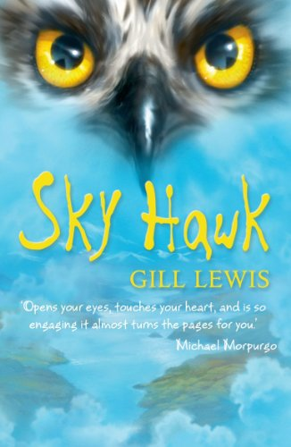
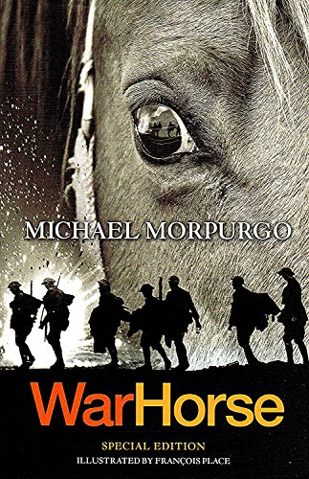



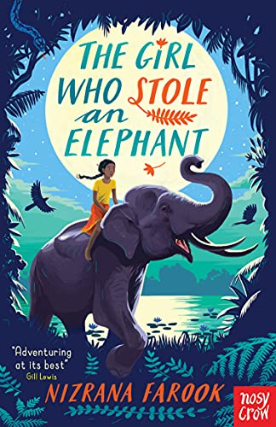
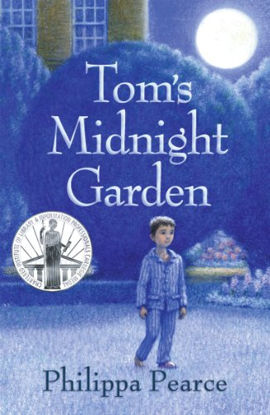
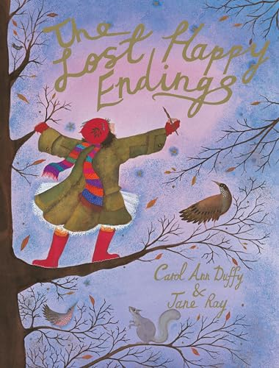
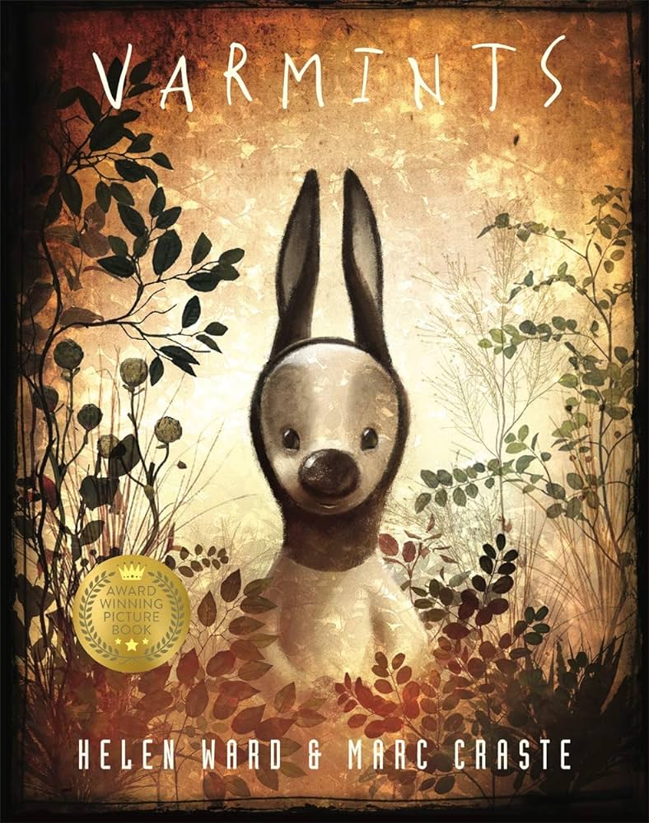
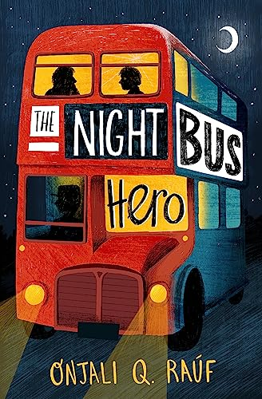

Reading for Pleasure Spine
Vikings– Year Five
Far From Home Berlie Doherty COURAGE | Everything’s Amazing Tom Gates Liz Pichon | Sky Hawk Gill Lewis COOPERATION | Danny, the Champion of the World Roald Dahl | War Horse Michael Morpurgo COMPASSION | The British History Timeline Wall Book
The Girl who Stole and Elephant Nizrana Farook | Tom’s Midnight Garden Phillipa Pearce | Lost Happy Endings Carol Ann Duffy | Varmints Helen Ward & Marc Caaste | The Night Bus Hero Onjali Rauf | The House at the Edge of Magic Amy Sparkes
Poetry: The Lost Words – Robert MacFarlane
Compare Reflect Discover

Slide 7












Reading for Pleasure Spine
Rother – Year Six
The Girl of Ink and Stars Kiran Millwood Hargrave COURAGE | The Lion above the Door Onjali Rauf | No ballet shoes for Syria Catherine Bruton COOPERATION | Queen of the Falls Chris Van Allsberg | Private Peaceful Michael Morpurgo COMPASSION | Anatomicum Katy Wiedermann
Holes Louis Sachar | Pig Heart Boy Malorie Blackman | Boy, Tales of Childhood Roald Dahl | Scrap Guy Bass | The White Giraffe Lauren St John | How to be more Hedgehog Anne-Marie Conway
Poetry: The Lost Words – Robert MacFarlane The Lost Spells - Robert MacFarlane
Compare Reflect Discover

